Slide 1
An Analysis on Tweets About Bong Go and His Candidacy for President in the 2022 Elections
Campos, Hizon, Maroket

Slide 2
01
The Context

Slide 3
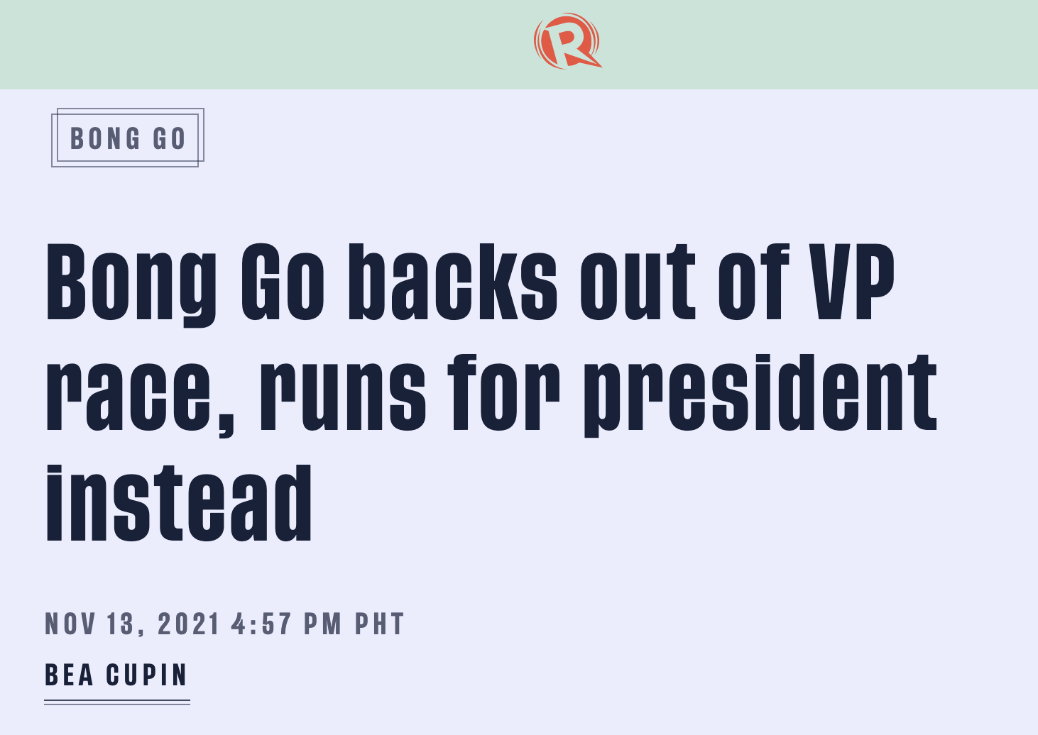
Last November 13, Senator Bong Go withdrew from his first candidacy as Vice President and instead chose to run for the position of President for the upcoming 2022 Elections.

Slide 4
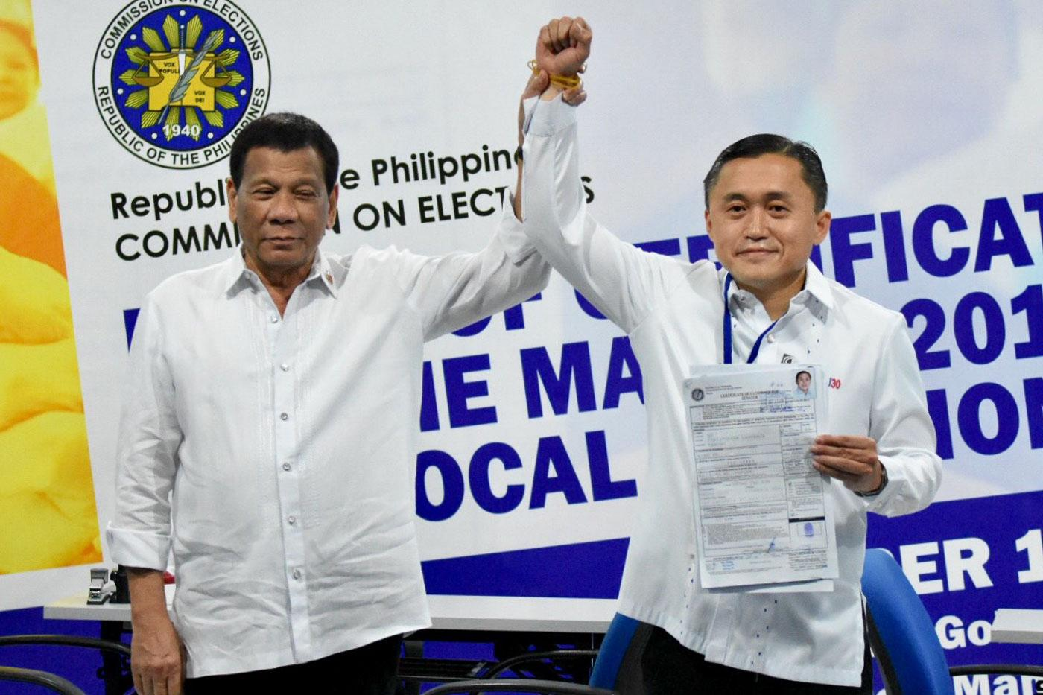
Though the current President Rodrigo Duterte has recommended Go to run for the position, this has caused an online discussion as Go would be competing against strong competitors, such as Bongbong Marcos.

Slide 5
02
The Goal

Slide 6
The Theory of Planned Behavior as a Framework for our study’s analysis
The TPB framework is used as a model for understanding and predicting intended behavior of human beings.
Applied to political elections, this framework can see use as a possible prediction model for voter preferences
For the sake of our study, we will focus on the ‘Attitude’ element of the theory, and extrapolate the attitude towards Bong Go candidacy for the Philippine presidency

Slide 7
Hypothesis
Public opinion towards Bong Go running for president would be positive
Analysis-Metric wise: This would entail a majority of tweets being classed as sentimentally positive based on their compound polarity score
This will enable us to assess attitude of the PH voter base towards Bong Go as a candidate
Public opinion would consider Bongbong Marcos to be a noteworthy rival against Bong Go
Analysis-Metric wise: Bongbong Marcos’ name must appear as a top-3o term in at least two topics out of three after using Gensim/LDA Topic Analysis on our dataset

Slide 8
03
The Data

Slide 9
Extract tweets with keyword “Bong Go” from current to November 13, when it was announced Bong Go would run for president.
Clean tweets in context form:
Removal of blank text
Removal of Twitter mentions and hashtags
Removal of non-alphanumeric characters
Removal of trailing and whitespaces
Removal of stopwords (for Topic Modeling only)
Translating of Tagalog words into English

Slide 10
Raw Tweets on Bong Go for President
date | username | tweet
11/17/21 | coachcrisol | Methinks Bong Go will eventually backout to give way to the Marcos Jr. and Sara tandem. #TheCircusContinues #GodHelpThePhilippines
11/17/21 | tgifbbm | Bong Go is Good but not a Leader material. ‚ÄºÔ∏è
11/17/21 | tweet_ronperez | I have nothing against Bong Go and I think he‚Äôs a good man who cares about the country and our fellow Filipinos, but I am sorry, he is no Duterte!

Slide 11
Cleaned Tweets on Bong Go for President
tweet | cleaned_text | removed_stopwords
@BJoie @gmanews @dzbb sinusunod lang ni bong go si digong. kapag sinabi ni digong sit uupo si Go. | bong go just follows digong when digong sit tells Go to sit down | bong go follows digong digong sit tells Go sit

Slide 12
03.1
On Tweet Translation

Slide 13
Language Barriers
One challenge of the dataset we collected and cleaned was that a large number of tweets were in Tagalog, which would not allow us to extract insight via VADER/Spacey.
Preparing this data therefore meant detecting tweets in Tagalog and translating them

Slide 14
Tagalog Tweet Detection
Given the use of English/Tagalog code-switching, binarily classifying tweets as Tagalog or English would be counterproductive and lead to false positives / negatives in detecting Tagalog Tweets. Instead, a discrete value could be used in order to establish the “Tagalogness” of a tweet

Slide 15
Tagalog Tweet Detection
This project defines “Tagalogness” as the proportion of Tagalog words in a tweet with relation to the total amount of words of said Tweet.
For this project, an English word is any case-agnostic string that is present in the list obtained from the words() list from nltk.corpus import words

Slide 16
Tagalog Tweet Detection
This therefore requires us to assume that the NLTK words list is sufficient enough for us to use as a sufficient (not perfect) litmus test for English words.

Slide 17
Sample of tweets with varying English Word Proportions
cleaned_text | EN_PERCENTAGE
What do you think Bong GO will do next | 1.000000
Makikinabang sa bbm vote ay si bong go and also isko and pacquiao but not leni Kaya wag nila isisi kay leni | 0.387097
Dinadaan na lang sa itsura dahil walang maibatong bahid Saka dyosko saksakan napan ng pangit itong si Nieto Parang niluwa sa pwet ni duterte na ang ama ay si Bong Go | 0.387097

Slide 18
Translation
We have decided to use the Google Cloud Platform’s Translation Service. A free tier is available for use.
Tweets with an English word proposition of less than 0.75 were flagged for translation.

Slide 19
Sample of Translation
cleaned_text | EN_PERCENTAGE
Sokatawa laugh the PDP E Duterte ran to another party left The PDP Bong Go is the same Tsk tsk Made humor and shame shame | 0.392857
It&#39;s ok with the voters Some of you vote for Bong Go Some of you vote for Bong Bong We have no problem with that Anyway VP Leni can&#39;t really get the DDS and BBM voters Just divide them int... | 0.377778
Hahahahha Envy PIKIT Thank you very much Sen Bong Go for your concern for the Filipinos. You are helping so much | 0.350000

Slide 20
Translation - Conclusion
Translation was effective to an extent--previously low English-proportion tweets now had more English words, save for some exceptions (contracted words like kmu or bwas were not detected for translation)

Slide 21
04
The Methodology

Slide 22
Study assumptions
Twitter tweets collected on the day of Bong Go’s announcement are representative of public opinion towards his candidacy
Compound polarity scores can be used to evaluate a tweet being ‘positive’, ‘negative’ , or ‘neutral’
Tweet sentiment strictly concerns Bong Go’s candidacy, and no other topic (other candidates mentioned like BBM)
Google Cloud’s Translate product produces sufficiently faithful translations for use in sentiment analysis
Evaluating proportion of Tagalog/English words in a phrase is sufficient to deduce how much of the sentence’s meaning is conveyed in the language constituting that proportion
Presence of BBM’s name in any of the tweets indicates comparison between Bong Go and BBM as presidential candidates

Slide 23
Perform Vader Sentiment Analysis on cleaned tweets
Getting polarity score of each tweet
Assigning of sentiment according to polarity score, based of thresholds from VADER developers
Perform topic modeling through Gensim LDA
Splitting tweets into individual words
Organizing into topics

Slide 24
05
The Results

Slide 25
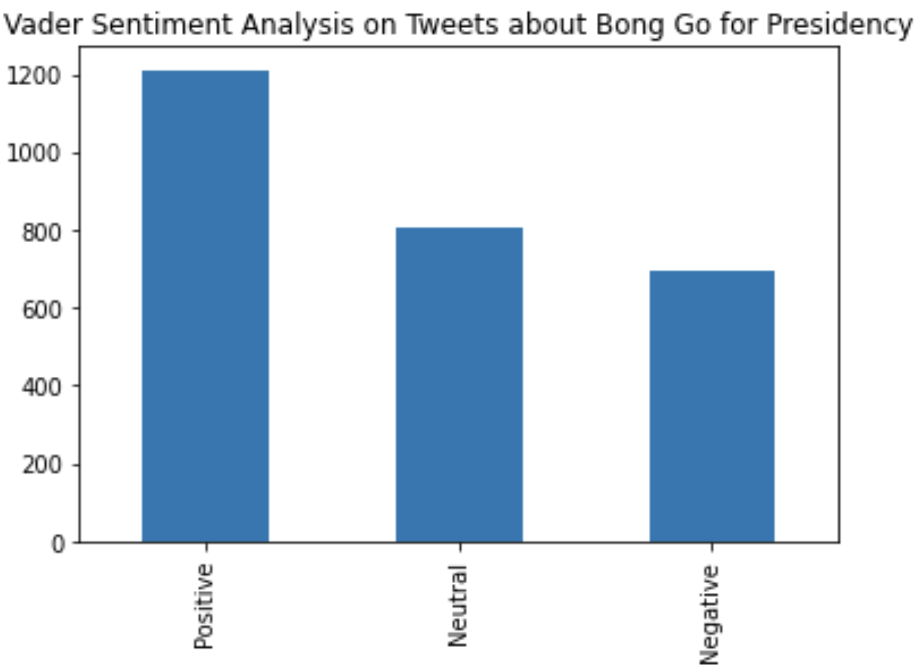
Vader Sentiment Analysis

Slide 26
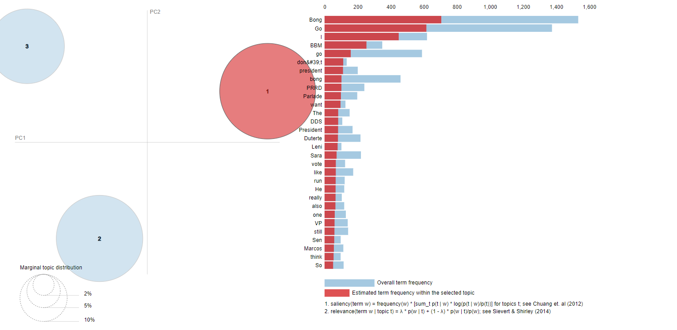
Gensim LDA Topic Modeling - appearance of term BBM

Slide 27
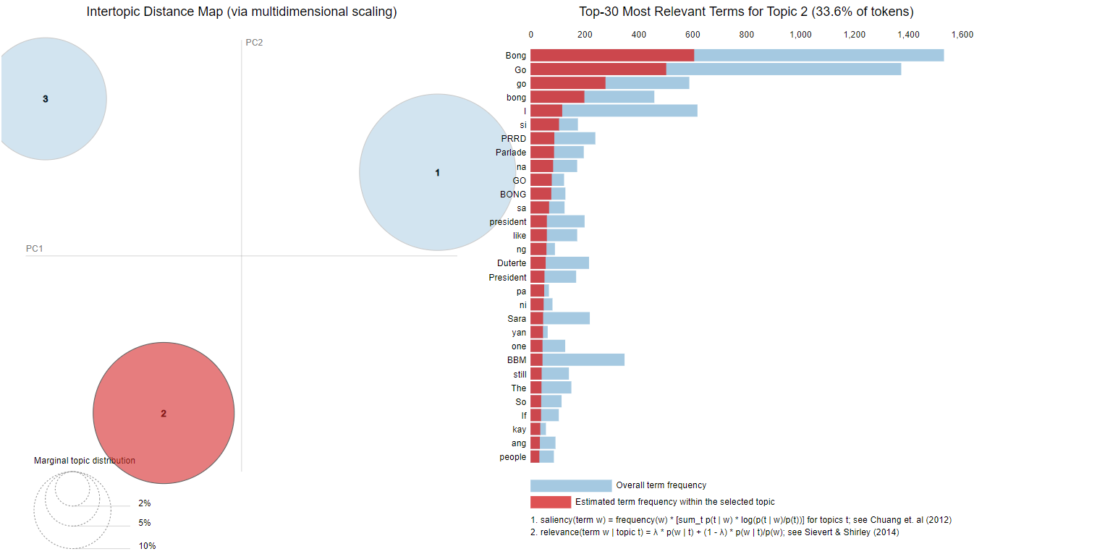
Gensim LDA Topic Modeling - appearance of term BBM

Slide 28
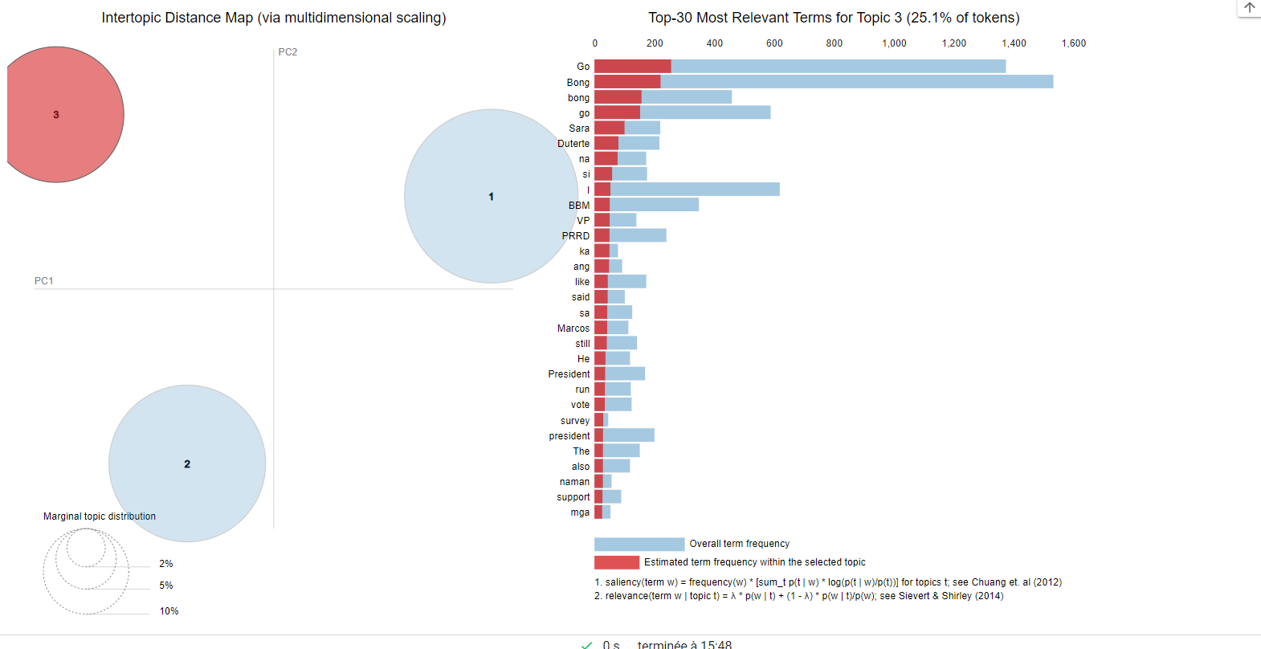
Gensim LDA Topic Modeling - appearance of term BBM

Slide 29
06
The Conclusion

Slide 30
TPB - Vader Sentiment Analysis
Based on the result of the sentiment analysis, assuming that Attitudes are equated to the sentiments, the majority of tweets show positive sentiments towards Bong Go’s run for presidency.
Therefore, the resulting attitudes of people who talk about Bong Go are also positive.
This may possibly indicate the intention to vote for Bong Go

Slide 31
Gensim/LDA Topic Analysis
The presence of BBM’s name in all three of the Gensim/LDA produced topics indicates interest in BBM as a rival against Bong GO for the presidential elections

